Slide 1





Sonic Cipher
24-1-R-2
Michael Ioffe
315388900
Shay Zak
312330749
Supervisor
Alex Keselman
1
Notes:
Hello everyone. My name is Shay zak and with me is Michael Ioffe. Today, we are excited to share our project, Sonic Cipher.

Slide 2

Introduction
Overcoming language barriers is crucial.
Developing a real-time voice-to-text translation web app.
Using Google Speech-to-Text, Google Translate, and ChatGPT APIs.
Enhancing communication and inclusivity.
2
Notes:
In our connected world where people use the internet all the time, it important to communicate easily, even if we speak in different languages. Our project is a web application that translates speech into text in real time and then translate it into another language. We use powerful tools like google speech to text, google translate, openAI ChatGPT. This app will help people understand each other better and make the communication between other languages much easier.

Slide 3

The Projects Goal
Objective:
Bridge language barriers with real-time translation
Provide seamless communication solutions
Ensure accessibility on all platforms
Focus:
Utilize Google's Speech-to-Text and Translate APIs
Incorporate OpenAI's ChatGPT
Implement peer-to-peer and asymmetric encryption
The Results:
Enhanced user satisfaction
Secure communication
Improved global communication
3
Notes:
Our project's main goal is to Overcome language obstacles with real-time translation. We want to make communication smooth and accessible on all platforms. To do this, we use use different APIs as I said previously . The result is an app that enhances user satisfaction and improves global communication, and will make their lives easier by having this tool.

Slide 4


Need For The Project
Current Issues with Translation Tools:
Lack real-time accuracy, context sensitivity, and privacy.
Our Solution:
Secure, real-time voice translation.
Uses advanced APIs.
Provides seamless user experience.
4

Slide 5


Our Solution
Real-time Translation
Advanced APIs
Speech Capture
Seamless Communication
5
Notes:
/////

Slide 6
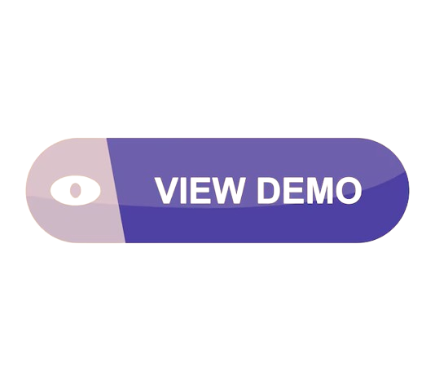
Live Demonstration
Between Goole Translate API and OpenAI API
6
Notes:
Now, let's look at a demo that will show how our app translates a sentence using two different methods. The sentence is "היא עזבה את החברה כי היא קיבלה הצעה טובה יותר."
Using Google Translate, it says: "She left the company because she got a better offer." Here, it's unclear who "she" refers to in the second part.
Using OpenAI, it says: "She left the company because she received a better offer." This version has more natural phrasing and clearly refers to the subject.
This shows how our app provides more accurate and natural translations with OpenAI. As well we can add user specifications which allows the user to change the context/way the text will be translated.

Slide 7
The Innovation In Our Solution
Voice Translation
Accurate Translations
User-friendly Interface
Multi-language Support
7
Notes:
Our project is innovative because it provides real-time voice translation using advanced APIs. The translations are context-aware and accurate, making conversations smooth and natural. We will design the interface to be user-friendly, so anyone can easily use it. Plus, our app supports multiple languages and dialects, ensuring that everyone can communicate effectively. This makes our solution unique and highly effective.

Slide 8
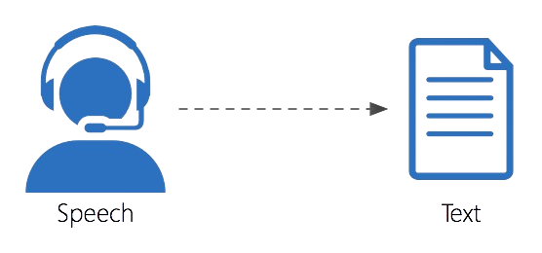
Google Speech-To-Text API
Supports 120+ languages.
Real-time transcription.
High accuracy.
Handles noise.
Customizable vocabulary.
8

Slide 9
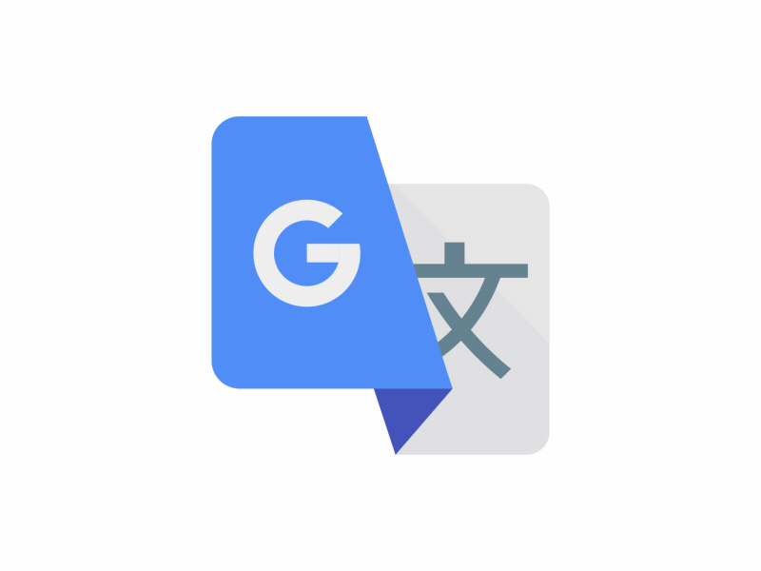
Google Translate API
Translates text in 100+ languages.
Accurate, real-time translation.
Auto language detection.
Integrates with Google services.
Text and speech translation.
9

Slide 10
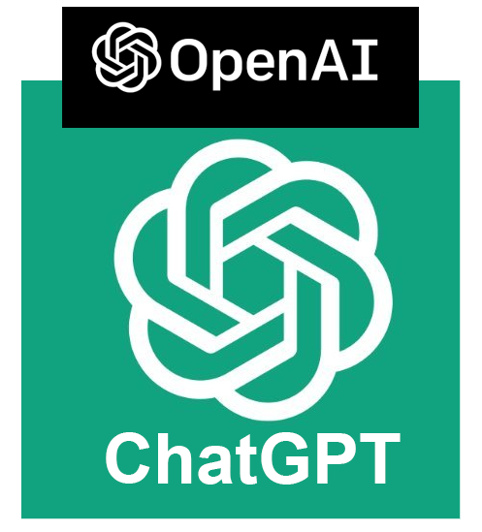
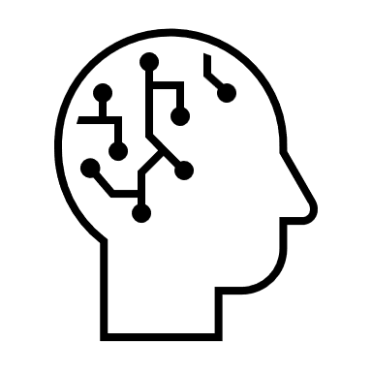
OpenAI ChatGPT API
Enhances context understanding.
Provides nuanced translations.
Supports multiple languages.
Generates human-like text.
Improves conversational accuracy.
Adapts to user input.
10
Notes:
Let's look at how we make API requests to OpenAI for translations. First, we compose a request that includes the transcribed text and specify the model, like GPT-3.5 turbo. We also include parameters like temperature and max tokens (tokens are for the length of the output, temperatures is for randomness of the output) . Next, we send the request using our API key. Once the API processes the request, it returns the translated text, which we then display to the user. We use the GPT-3.5 turbo which is the most recommended model for our requests because it is reliable, fast, and precise, ensuring the best translation quality.

Slide 11
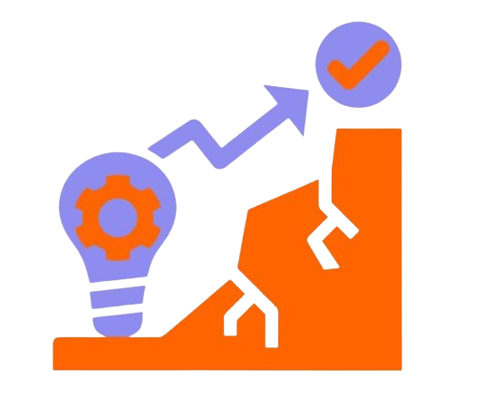

Challenges
Combining multiple APIs.
Minimizing latency.
Ensuring precise translations.
Managing background noise.
11
Notes:
let's discuss the challenges we are facing. Combining multiple APIs is complex because each API has its own way of handling data. It will take a lot of hard work to minimize latency to ensure translations happen quickly by trying to play with different models and the approach of the translation request. Ensuring precise translations is another challenge, especially with different languages and dialects.
And from what we studied by far, managing background noises will be another challenge we will have to face in our implementation.

Slide 12
Flow-Voice Capture and Translation Flow
01
03
05
Select Languages
Voice Input
(Start Recording)
Display Transcribed Text
02
04
06
Speech-to-Text Conversion
Translate Text
Choose Translation Method
12

Slide 13
Free- Google Translate API
Flow-Text Translation
01
03
05
HTTP request to Google Translate API
Play the translation
Display Translation
04
02
Google Text-to-Speech API
Process Translation
Premium- OpenAI ChatGPT API
01
03
05
HTTP request to OpenAI API
Translation Displayed
Receive users Specification
04
06
02
Receive captured text
Process Translation
Play The translation
13

Slide 14
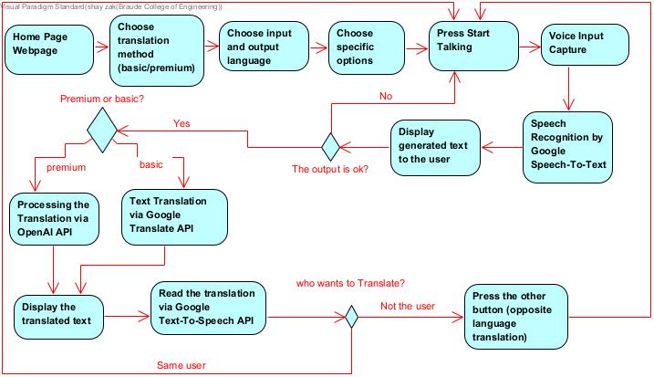
Flow Diagram
14

Slide 15
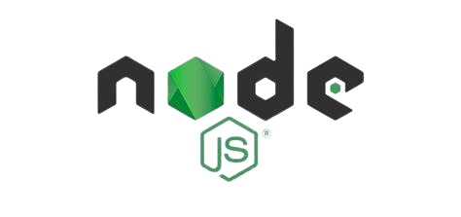
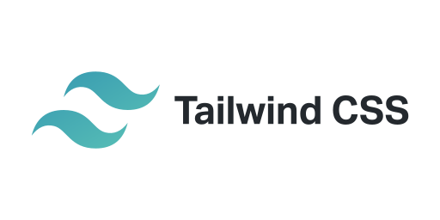

Implementation
Node.JS
Preact
Backend
Frontend
15
Notes:
Now lets talk about the implementations in our project. For the frontend, we use Preact, which is lightweight and efficient, ideal for our application. We also use Tailwind CSS for styling, allowing us to create custom designs quickly and maintain a consistent look and feel. The backend is built with Node.js, which helps us handle API requests and manage data more smoothly. This combination of Preact, Tailwind CSS, and Node.js will promise that our application is responsive, scalable, and provides a good user experience with real-time translations and secure data handling.

Slide 16
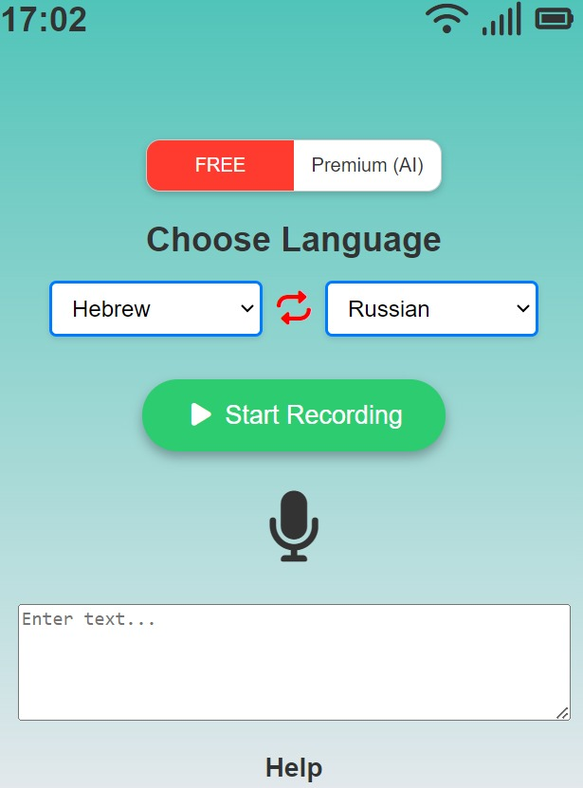
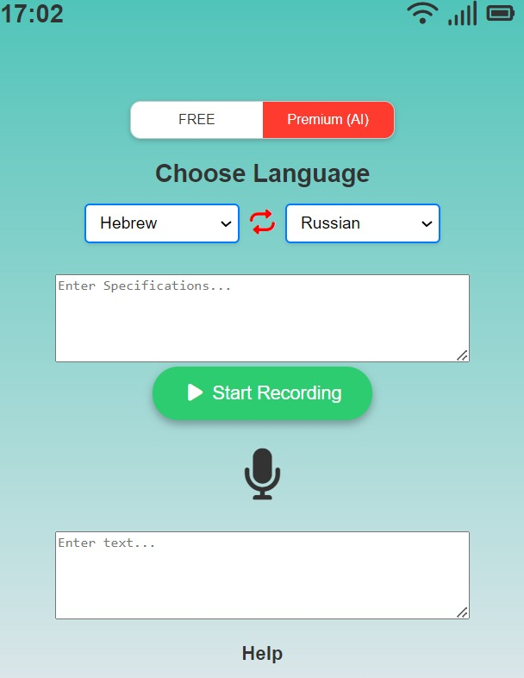
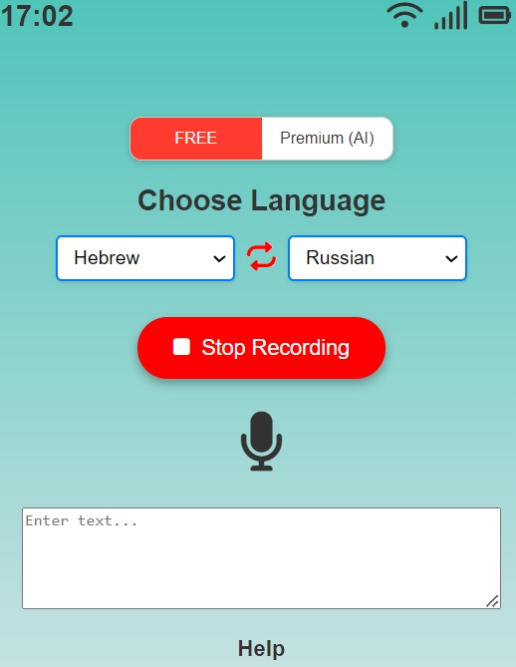
Interface
Free
Premium
16

Slide 17
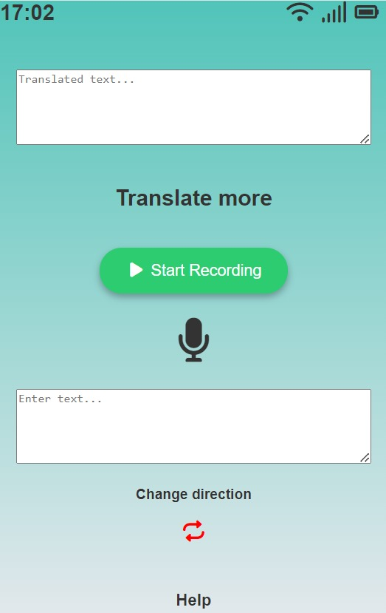


Interface
(after translation)
17

Slide 18

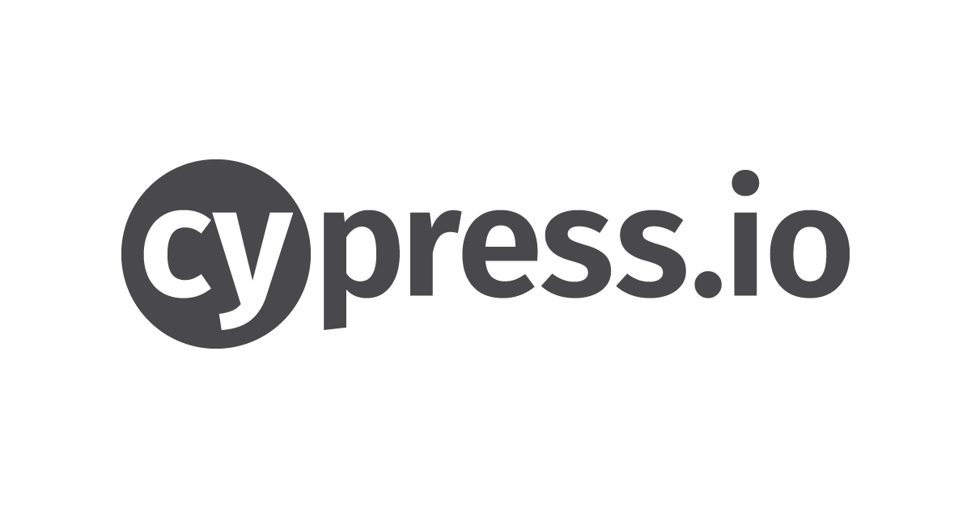
Verification And Testing
Frontend Testing
BackEnd Testing
Speech-to-text
Translation accuracy
Text-to-speech
Device compatibility
Browser compatibility
Response time
Latency
API call speed
Heavy user load
Testing Frameworks
18
Notes:
We will thoroughly test both the frontend and backend of our application. For the frontend, we will focus on testing voice capture, speech-to-text conversion, translation accuracy, and text-to-speech playback. We will also ensure compatibility across different devices and browsers. For the backend, we will test response times, latency, API call speed, and scalability under heavy user loads. This comprehensive testing plan will ensure that our application is reliable, performs well, and provides a great user experience.

Slide 19
Thank you for Listening
Questions?
19
Notes:
אליאב

